Slide 1
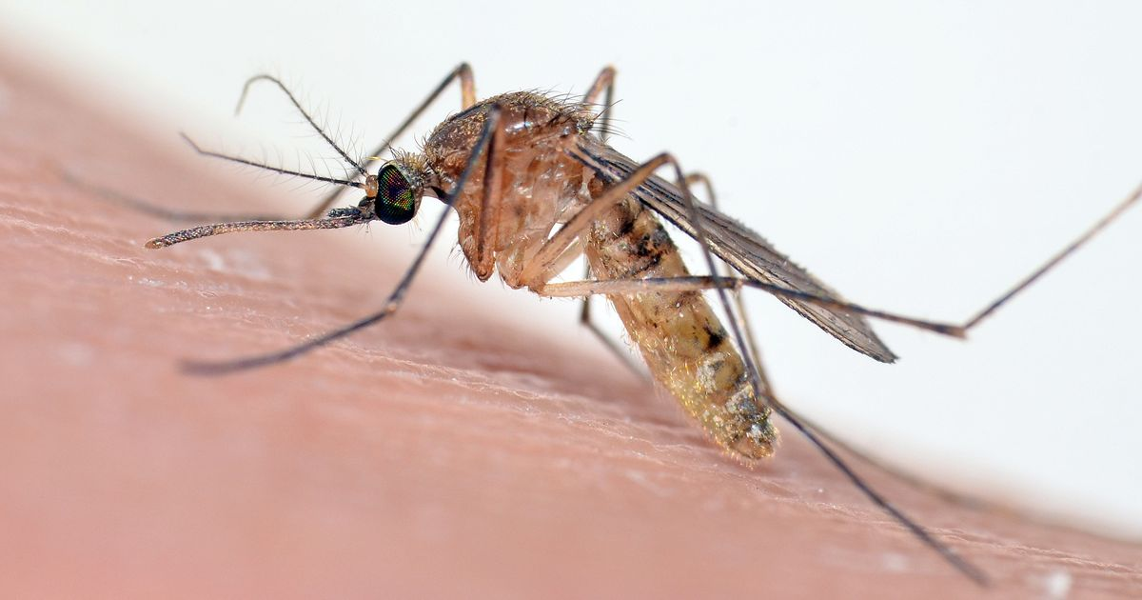
SMARRT Consulting Group
Chicago West Nile Virus Action Plan
Team
Andrew Cooper Ted Inciong
Rachel Dudle Mike Kapelinski
Stephen Hage Rahul Sangole

Slide 2
Presentation Format Slide
White Century Gothic Font 18 for regular text
Size 28 for titles
Century Gothic 28 for titles and 18 for general text

